Slide 1
Covid 19 data visualization

Slide 2
BRIEF History Of Covid 19 pandemic
The Covid 19 pandemic also known as coronavirus pandemic, is an ongoing global pandemic caused by severe acute respiratory syndrome coronavirus 2 “SARS-CoV-2”. This novel virus was first identified from an outbreak in WUHAN, China, in December 2019. attempts to contain it there failed, allowing the virus spread to other areas of China and later worldwide.
The world heath organization “WHO” declared the outbreak a public heath emergency of international concern on 30 January 2020 and a pandemic on 11 March 2020.
As of 27th September 2022, the pandemic has caused more than 603.5 million cases and 6.5 million confirmed deaths, making it one of the deadliest in history.

Slide 3
Project breakdown
The data used in this project was provided by John Hopkins CSSE Covid 19 global data set. The data was imported from github.com into an excel sheet, cleaning and transformation of data was carried out using power query, power pivot and excel functions.
Graphs and charts were created using pivot table and chart to show the relationships between the confirmed ,deaths and recovered cases of countries and rate by year.
The bar charts were used to show the 5 top countries that have the highest number of confirmed and deaths cases. While the line graph was used to show the confirmed and deaths rate by year as shown in the next slide.

Slide 4
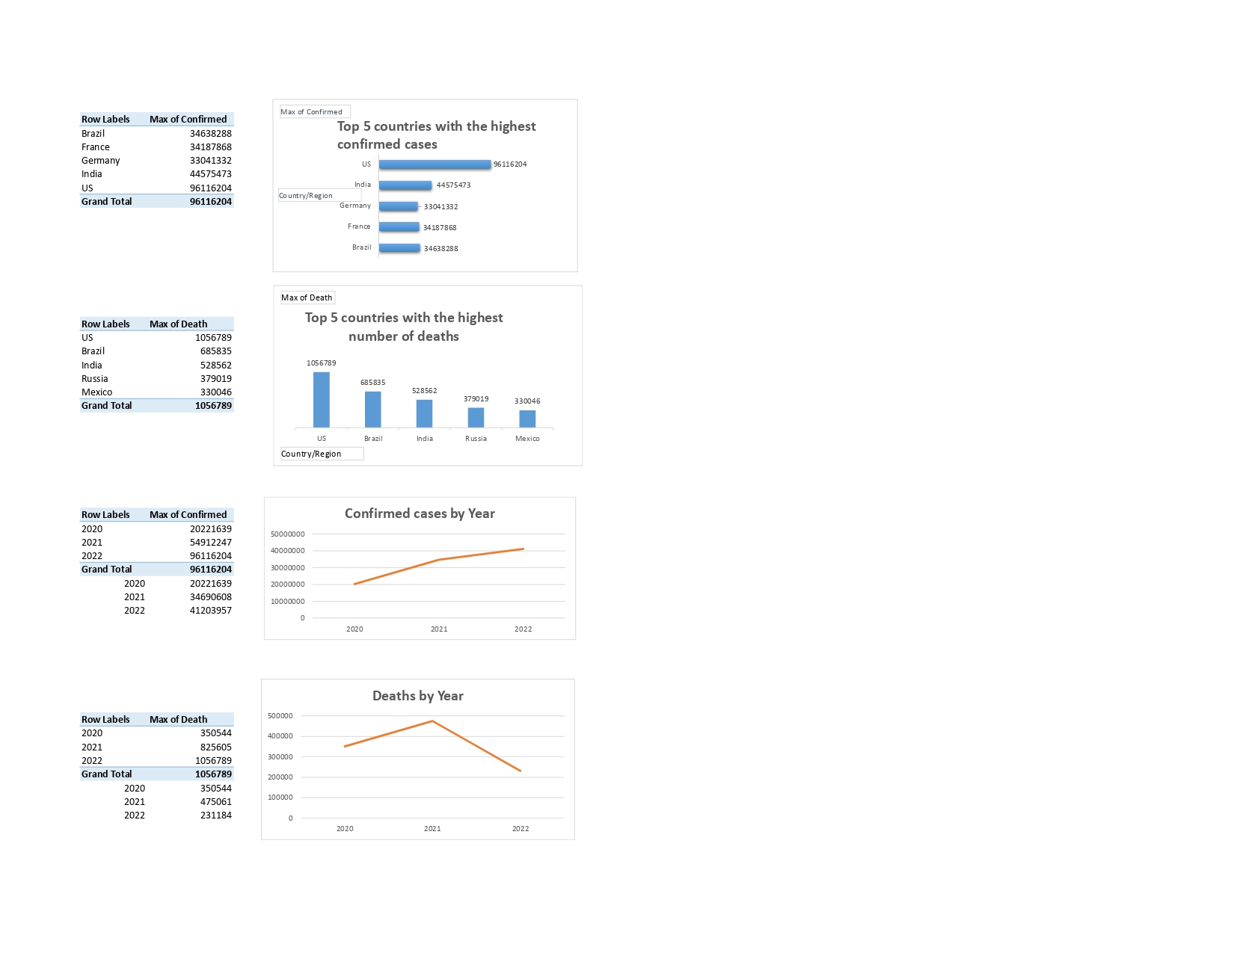

Slide 5
DATA Analysis
Form the top 5 countries shown using the bar chart, us has the highest number of cases, with a total of 96.1 million followed by India with a total of 44.5 million. That’s a difference of 51.5 million.
US also has the highest amount of death cases with a value of 1.1 million followed by Brazil with 685,835. that’s a difference of 370,954.
The line charts shows the confirmed and death cases by year. In 2021, we have the highest death cases with 475,061 while 2022 has the lowest death cases with 231,184.
2022 has the highest confirmed cases with 41.2 million. while 2020 has the lowest confirmed cases with 20.2 million.

Slide 6
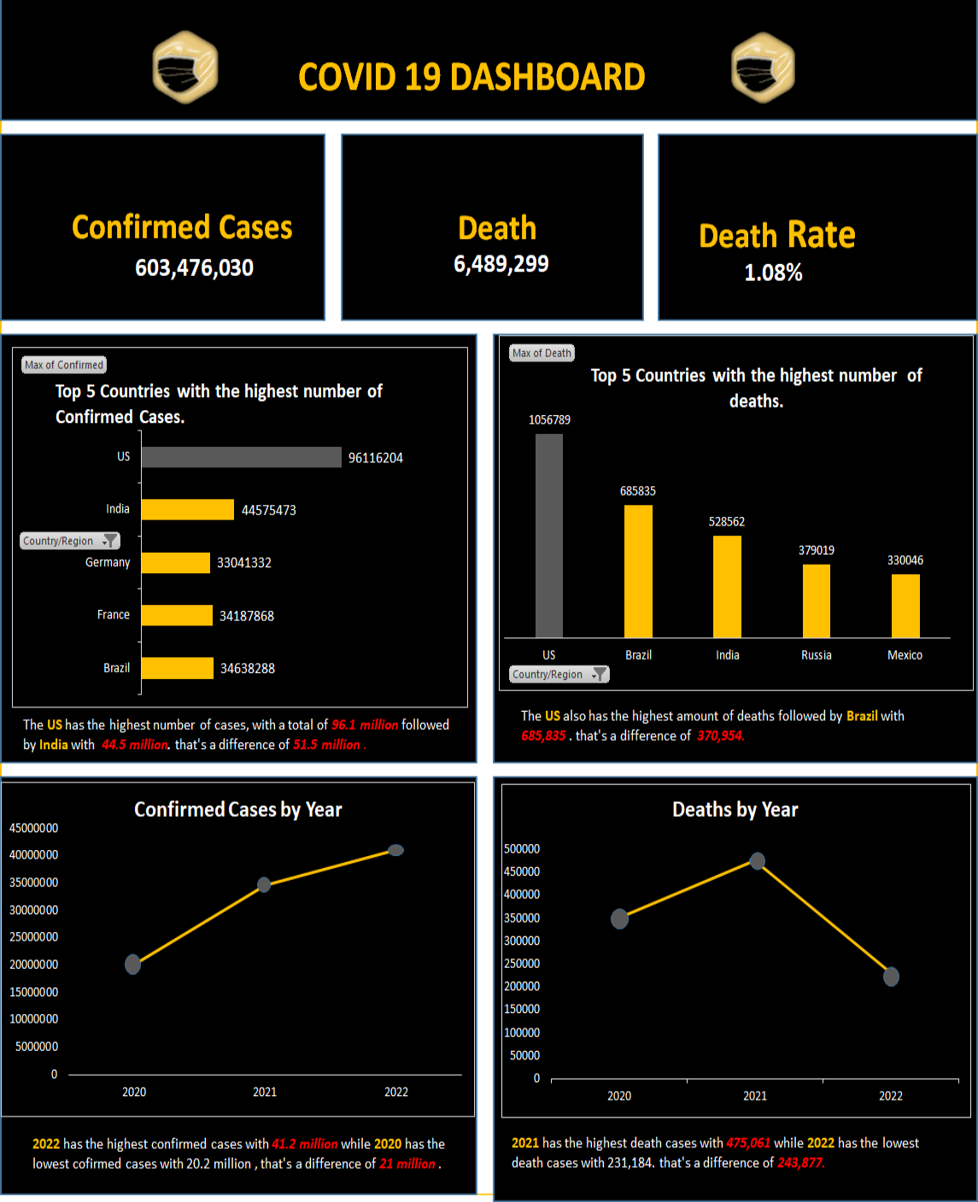
Covid 19 Dashboard

